Slide 1
Company
Date
Buy, Hold, Sell…..Run Away?
Notes:
This is a review of Tesla and its financial outlook using publicly available data, some AI interpretation of that data and random commentary.

Slide 2
Disclaimer
For Infotainment only
Notes:
Our AI systems are definitely not licensed financial advisors.
The information shown in the following is largely scraped from the Internet and you know how that usually goes, so beware.
Pause: 1.0
The information provided should not be considered financial advice. Any content or responses are for informational purposes only and do not constitute professional financial guidance. Decisions based on such information are at your own risk. Always consult with a qualified financial professional before making any investment or financial decisions. I do not endorse or promote specific financial products, and any discussions about financial concepts are general in nature. Individual financial circumstances vary, and it is crucial to conduct thorough research or seek personalized advice tailored to your situation.
Pause: 1.0
Use your own common sense and talk to the professionals before making any financial decisions.

Slide 3

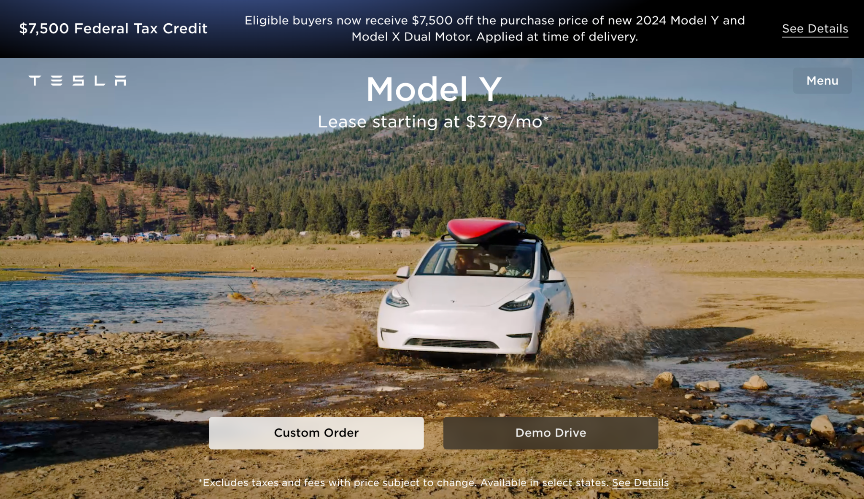
Tagline
Notes:
Tesla
Pause:1.0
Founded in 2003 by Martin Eberhard and Marc Tarpenning, Tesla, Inc. originated as an electric vehicle (EV) manufacturer with a mission to accelerate the world's transition to sustainable energy. The company gained prominence when entrepreneur Elon Musk led a substantial investment round in 2004, becoming a driving force in Tesla's development. Tesla's first product, the Roadster, debuted in 2008, showcasing electric cars' viability with impressive range. Over the years, Tesla expanded its lineup to include the Model S, Model 3, Model X, and Model Y, covering a range of market segments. Renowned for their performance, cutting-edge technology, and long-range capabilities, Tesla's vehicles have revolutionized the automotive industry, influencing a broader shift towards electric mobility. In addition to electric cars, Tesla has delved into energy solutions, producing solar products, energy storage systems like the Powerwall, Powerpack, and Megapack, and creating sustainable energy ecosystems. Tesla's innovative approach, spearheaded by Elon Musk, has positioned the company as a key player in both the automotive and clean energy sectors, driving global conversations about the future of transportation and environmental

Slide 4
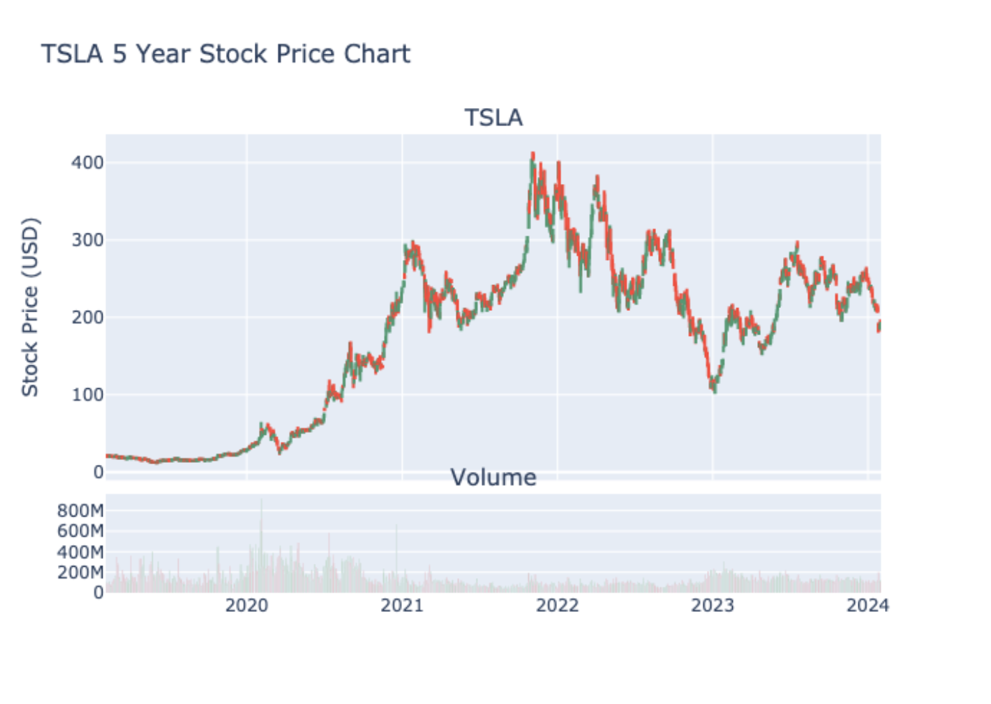
Stock Long Term

Slide 5
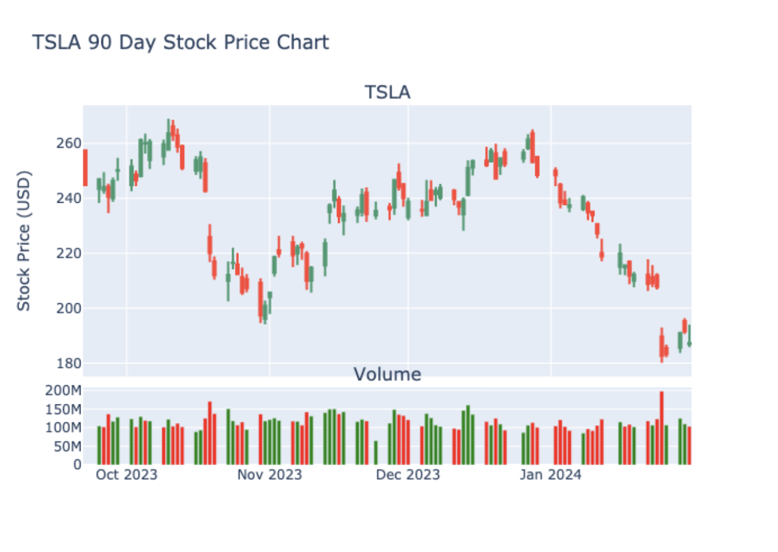
Stock Last Quarter
Notes:
In the last 90 trading days Tesla stock has lost 25% of its value with more down days than up days. There have been a couple of significant down gaps on Oct 25th and Jan 31st.
The stock attempted a sustained rally during the period but it is down significantly in the past three weeks.

Slide 6
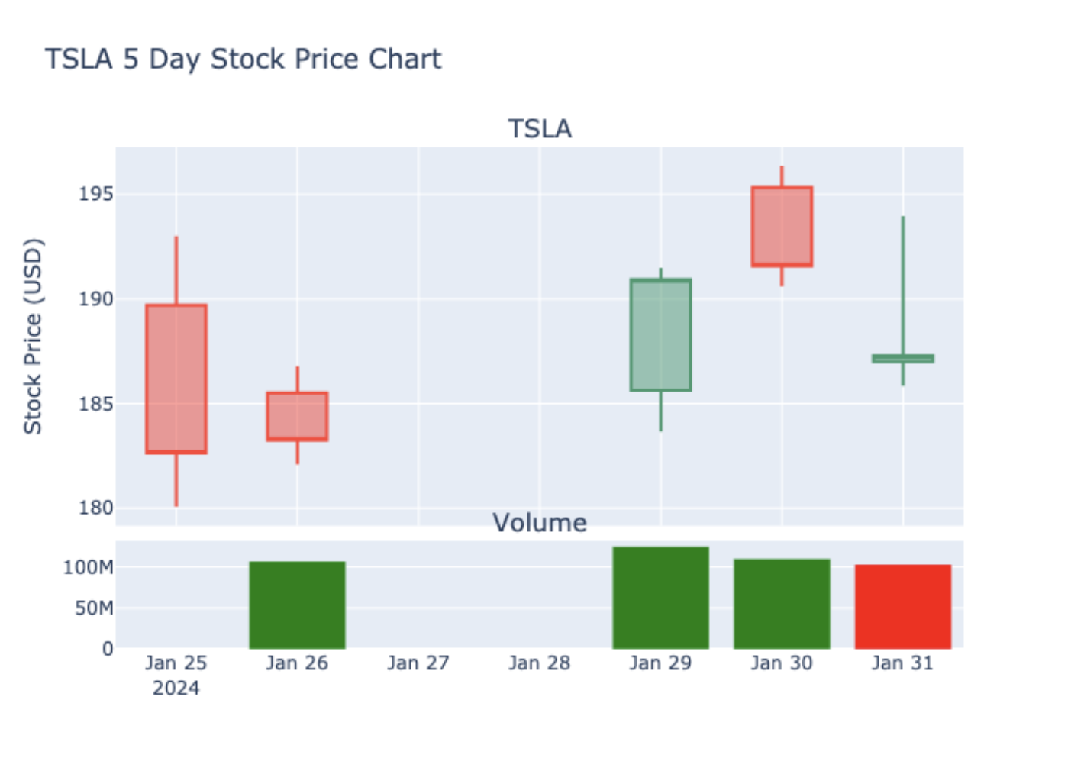
Past Week
A candle chart visually represents the price movement of a financial asset over a specific time period by using candlestick-shaped symbols to depict the opening, closing, high, and low prices for each interval.
Notes:
The large down candle on Jan 25th was a 7% drop in the price.
The following day confirmed the drop.
The rise on the 29th regained the lost value, but the rally fell short on the following day.
The near gravestone doji pattern on Wednesday is a bearish that often forecasts a longer term downward trend.
The inverted hammer on Wednesday indicates a possible change in the downward trend.

Slide 7
Headlines
Headline1
Headline2
Headline3
Headline4
Headline5
Headline6
Headline7
Headline8
Notes:
The latest Tesla related headlines include
Pause:1
Spotify signs new deal with popular US podcaster Joe Rogan
Magnificent Seven Stocks To Buy And Watch: Amazon, Meta Surge; Nvidia Rallies To Record High
Tesla Recalls Millions of Vehicles Amid Probe of Autopilot Crashes
Bezos Discloses Plan to Sell Up to 50 Million Amazon Shares as Stock Surges
Interest rates ‘to fall to just 4.5pc’ this year after US jobs shock
Tesla stock slips further after recalling over 2 million EVs
CEO Zuckerberg Will Get $700 Million in Income From Meta’s New Dividend—and a Hefty Tax Bill
Tesla agrees to pay $1.5 million to settle California hazardous waste lawsuit

Slide 8
Direction

Slide 9
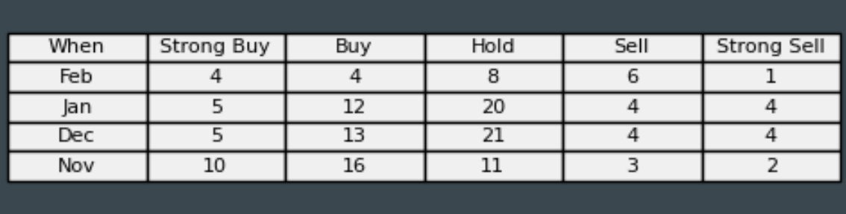
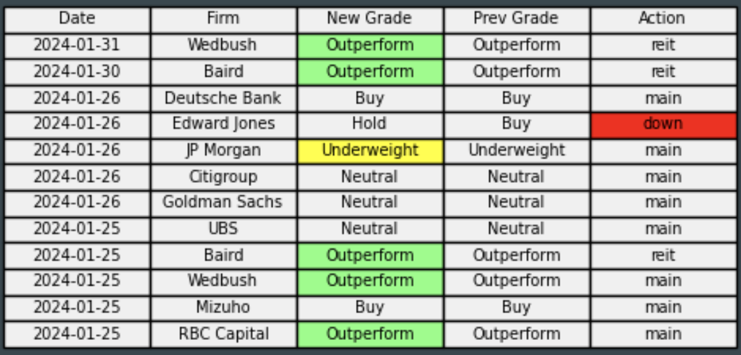
Analysts

Slide 10
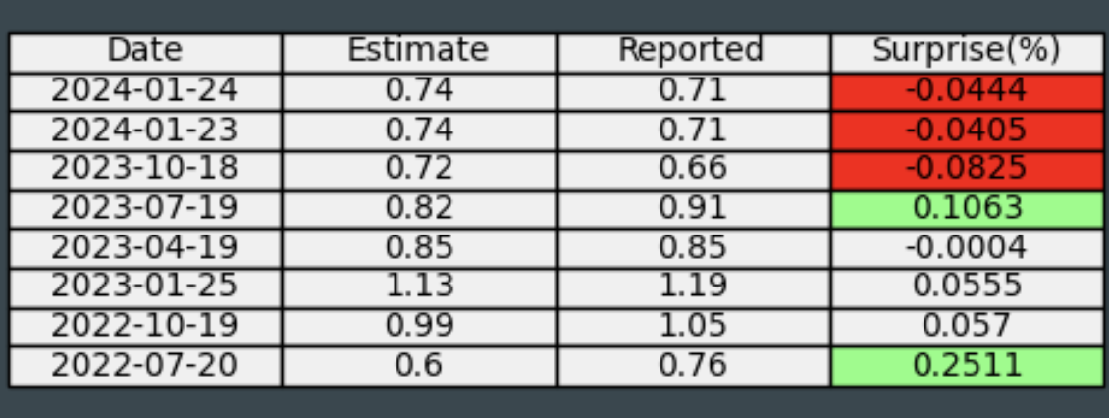
EPS
Next
Notes:
The last few earnings reports have not met estimates but they were close.
Pause: 1.0
Next earnings will report on April 17th with a current estimate of 68 cents per share.

Slide 11
Now some tech graphs

Slide 12
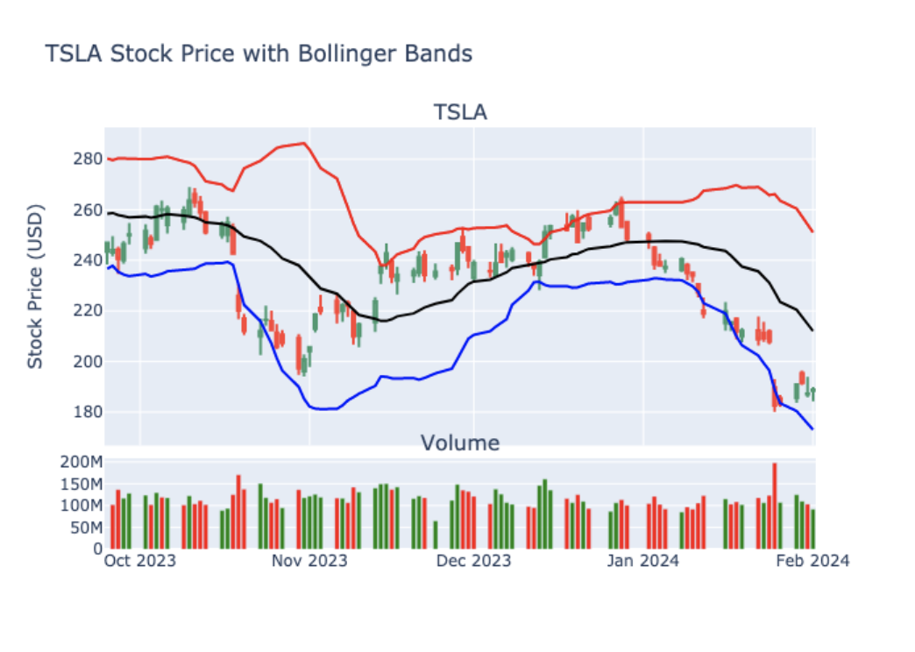
Bollinger Bands
Bollinger Bands are a volatility indicator consisting of a middle band being an N-period simple moving average, flanked by upper and lower bands representing N-period standard deviations from the moving average, used to identify potential overbought or oversold conditions in a financial instrument.

Slide 13
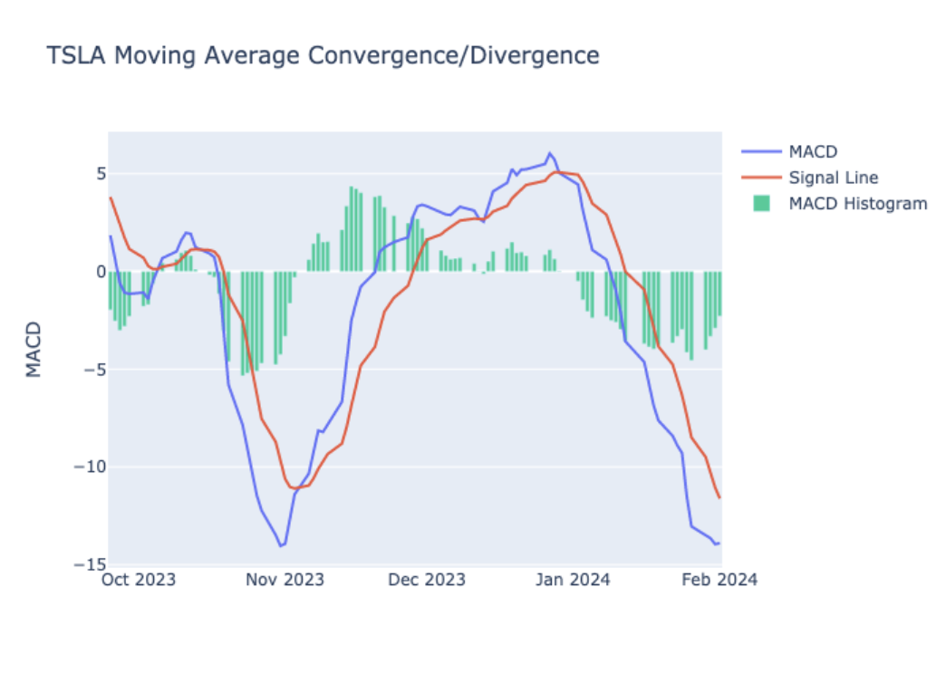
MACD
The Moving Average Convergence Divergence (MACD) is a trend-following momentum indicator that calculates the difference between two Exponential Moving Averages (EMAs) of an asset's price, revealing potential buy or sell signals when the MACD line crosses its signal line.

Slide 14
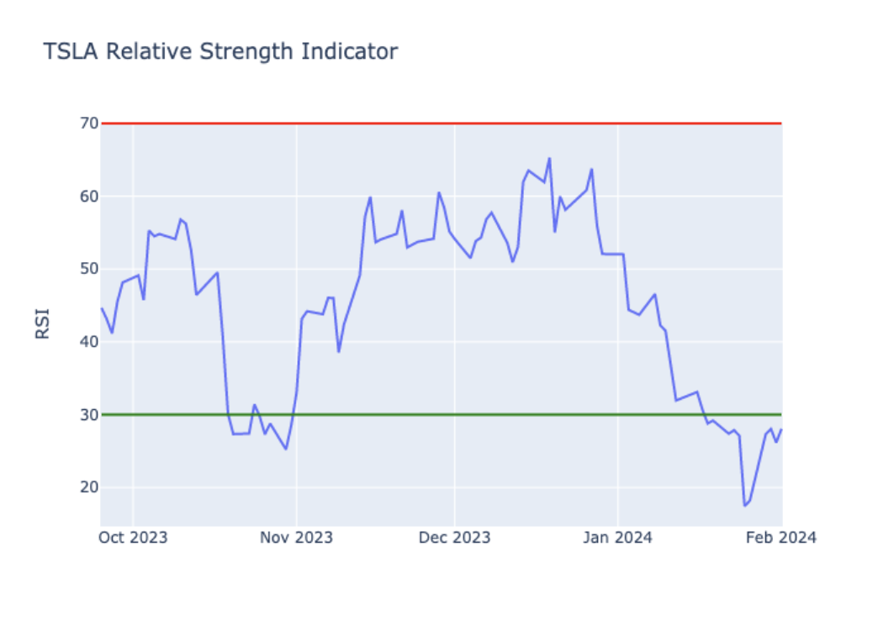
RSI
The Relative Strength Index (RSI) is a momentum oscillator that measures the speed and change of price movements, indicating potential overbought or oversold conditions for a stock, typically on a scale from 0 to 100. Above 70 is overbought and under 30 is oversold.

Slide 15
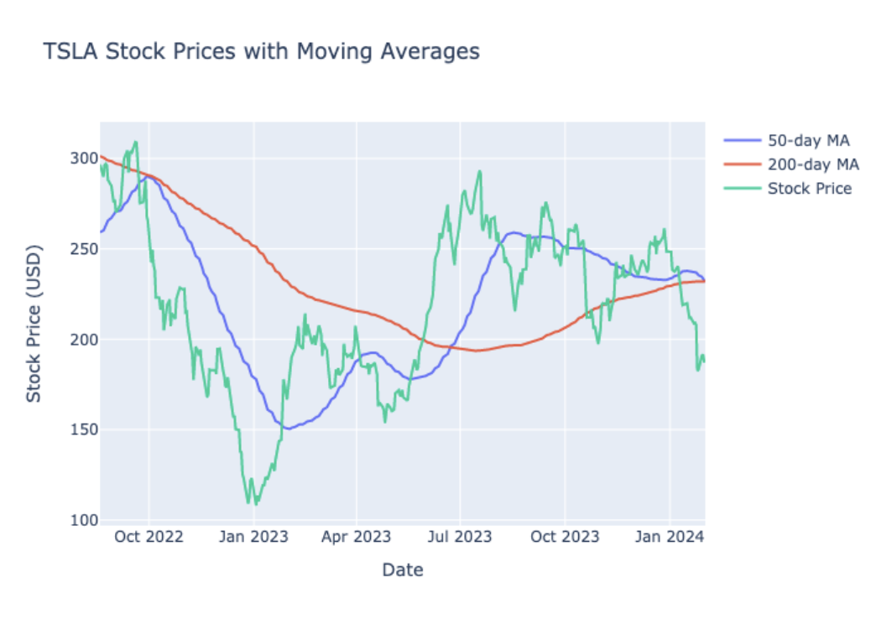
Moving Averages
The Relative Strength Index (RSI) is a momentum oscillator that measures the speed and change of price movements, indicating potential overbought or oversold conditions for a stock, typically on a scale from 0 to 100. Above 70 is overbought and under 30 is oversold.

Slide 16
Trend Lines

Slide 17
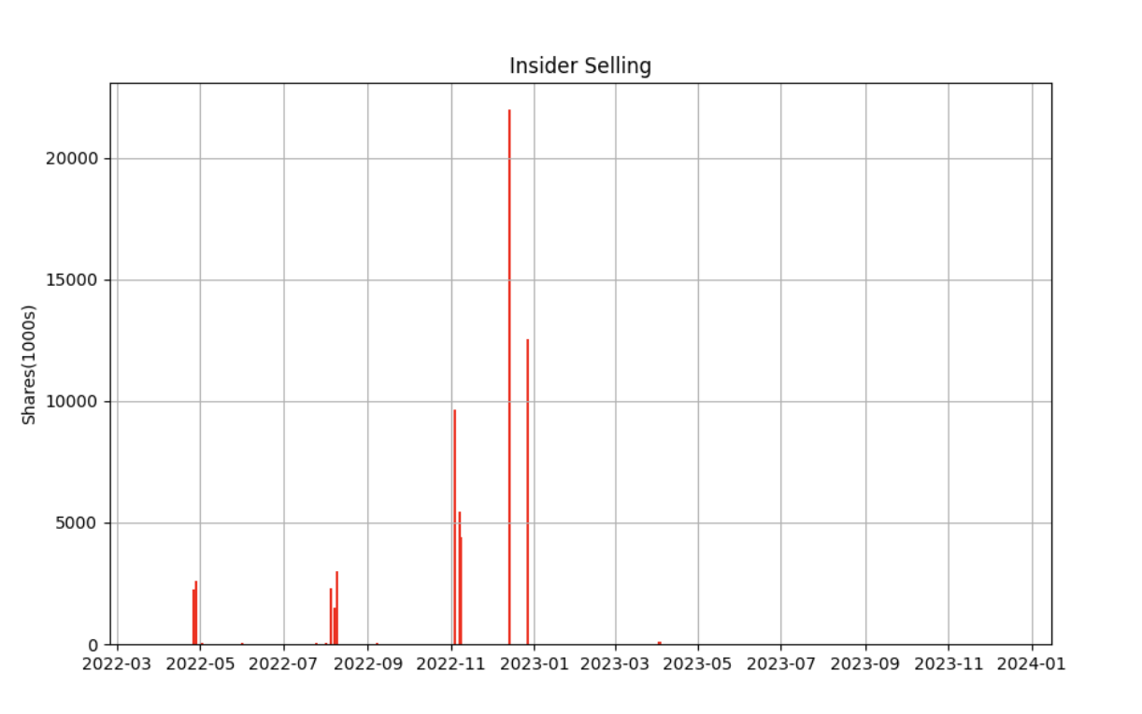
Insider Report

Slide 18
AI Price Prognostication
Today
$187.29
30 Days
$181.07
90 Days
$173.81
180 Days
$183.43
365 Days
$197.12
Notes:
This is the artificial intelligence guess for the

Slide 19
Summary
Notes:
So is it time to buy or hold or sell Tesla? Pause:0.75 Or maybe just run away?

Slide 20
Recommendation
Notes:
Tesla has had a great run and great long term potential but has been on a recent downward slide so maybe wait a bit. Check out the Financial App Name for notifications on when it might be a good time to buy and for more infotainment on stocks, foreign exchange, and crypto trends.
Go to Financial App Name to suggest a stock that you would like us to review. See the link in the comments.
Remember that this is just for entertainment. Please consult your financial advisor, barber, rabbi, talk radio hosts or anybody else. Don’t make financial decisions based on this information and don’t blame us if you lose money. We would not be doing this if we knew how to make money with stocks. Please like and subscribe to get more content like this.

